Slide 1
Figure 1-1

Slide 2
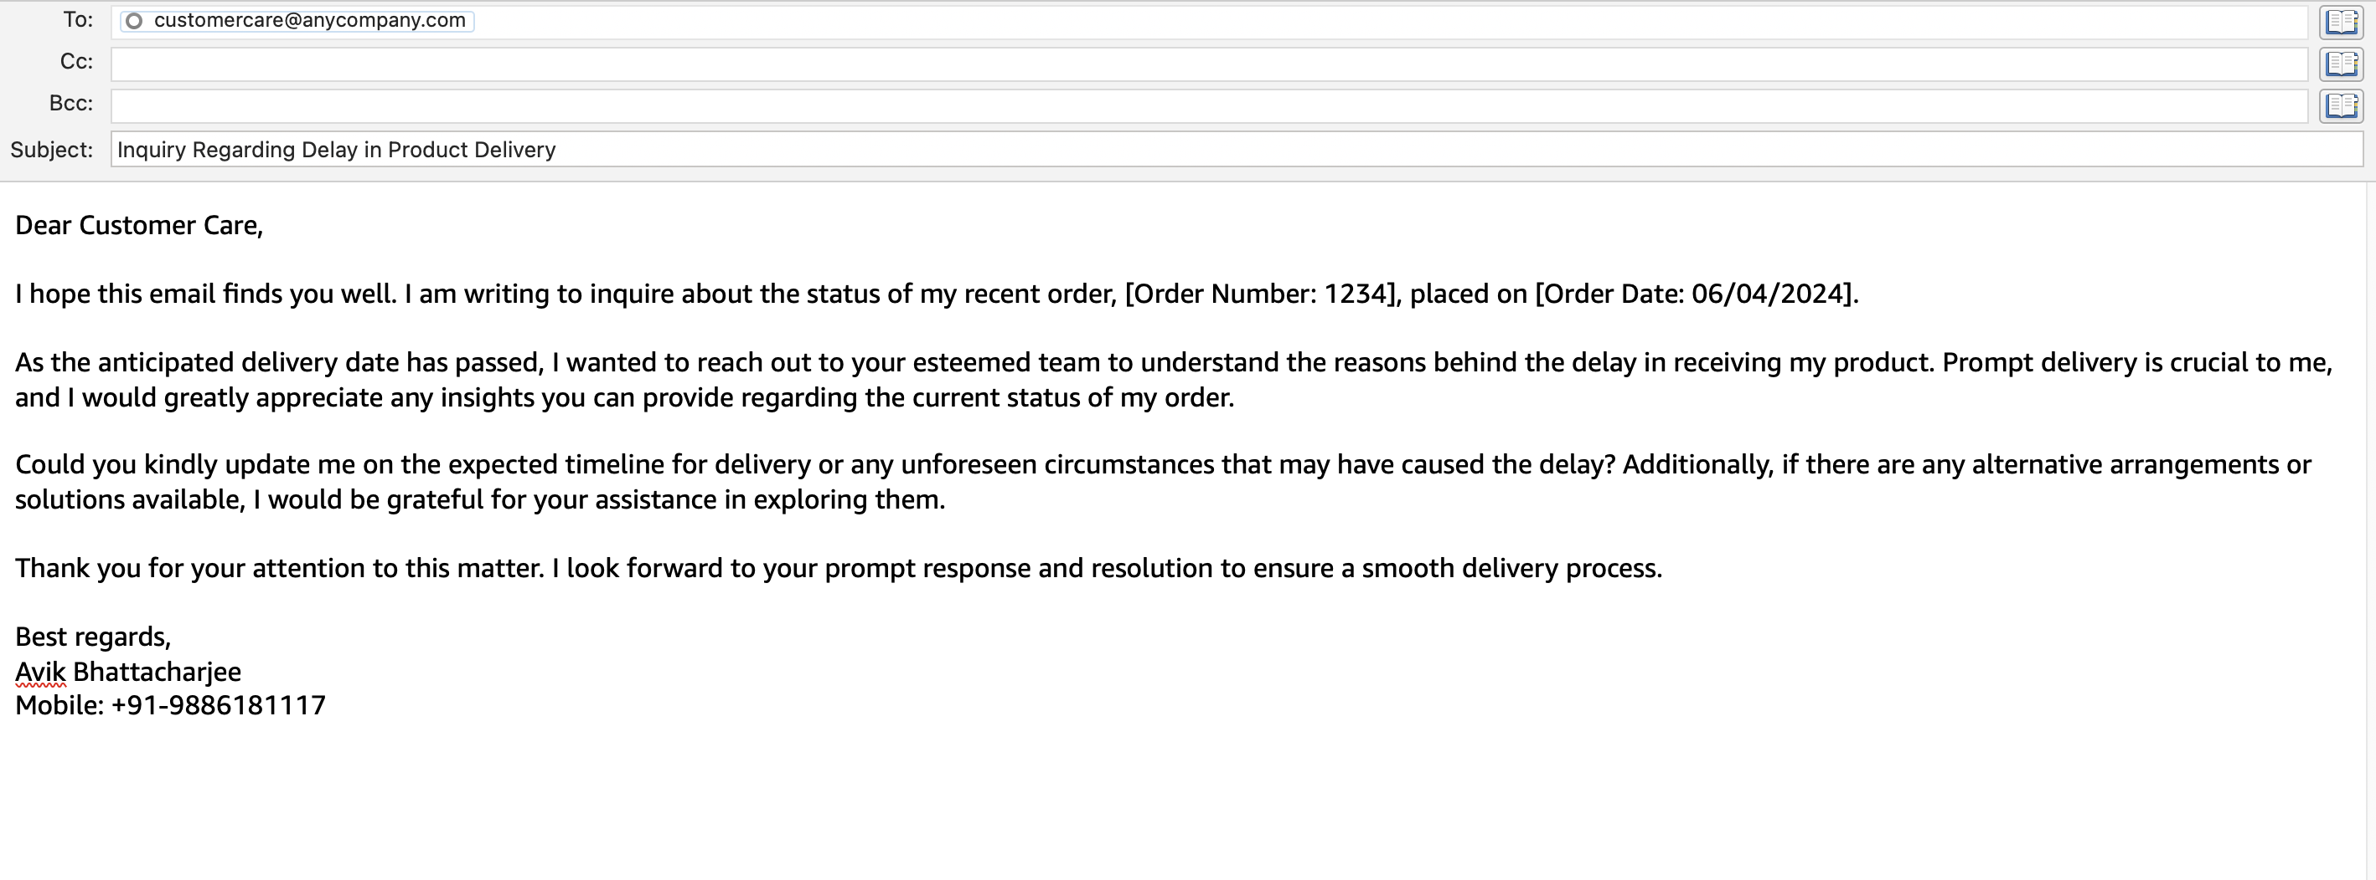

Slide 3
Figure 1-2

Slide 4
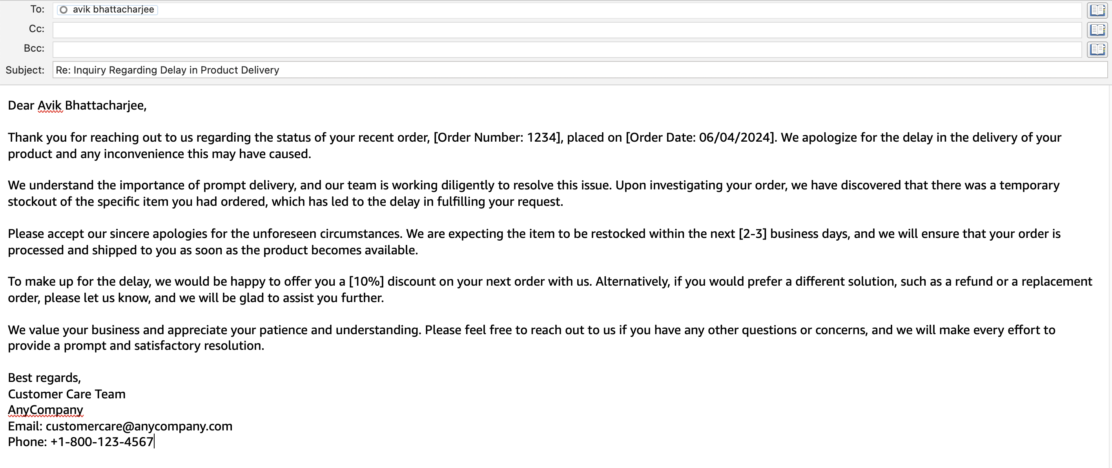

Slide 5
Figure 1-3

Slide 6
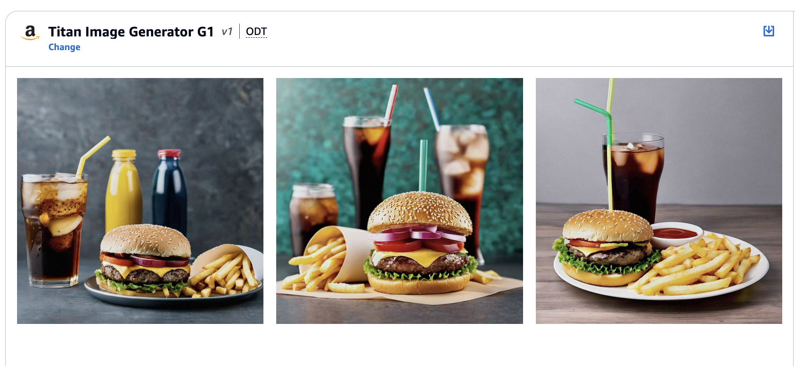

Slide 7
Figure 1-4

Slide 8
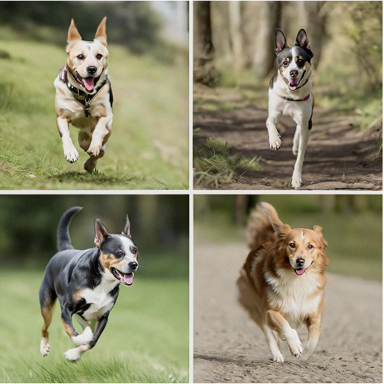
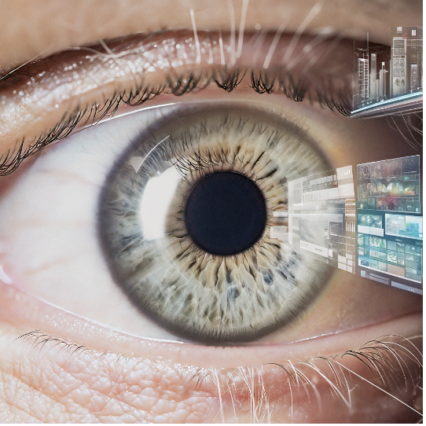
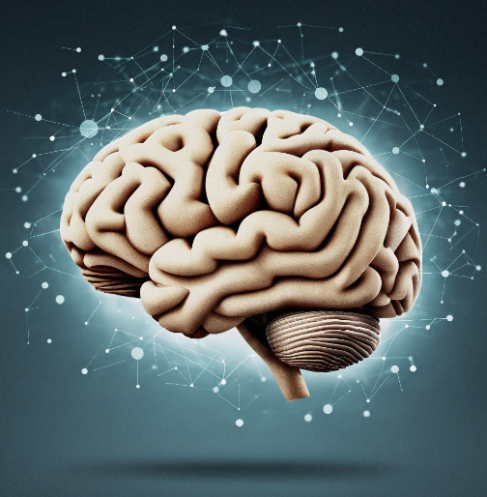
It is a Dog.
observe
visual perception
cognitive reactions
Human vision schematic flow

Slide 9
Figure 1-5

Slide 10
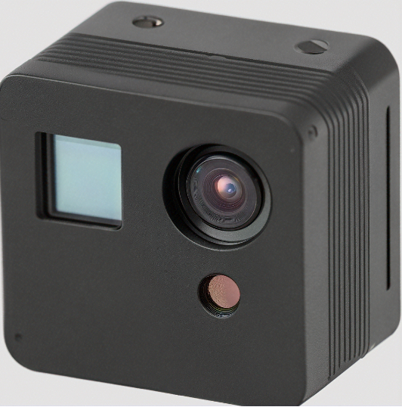
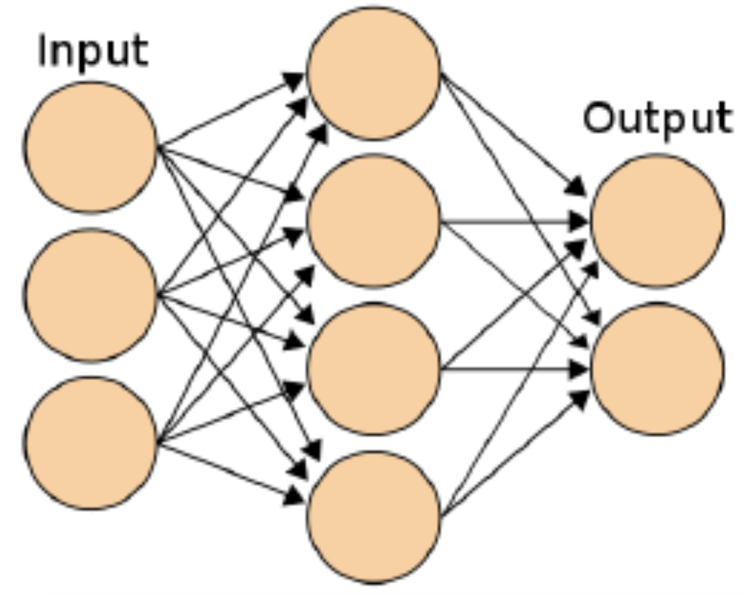
It is a Dog.
Capture
Feeding neural network
cognitive outcome
Artificial Intelligence (AI) Computer vision schematic flow

Slide 11
Figure 1-6

Slide 12
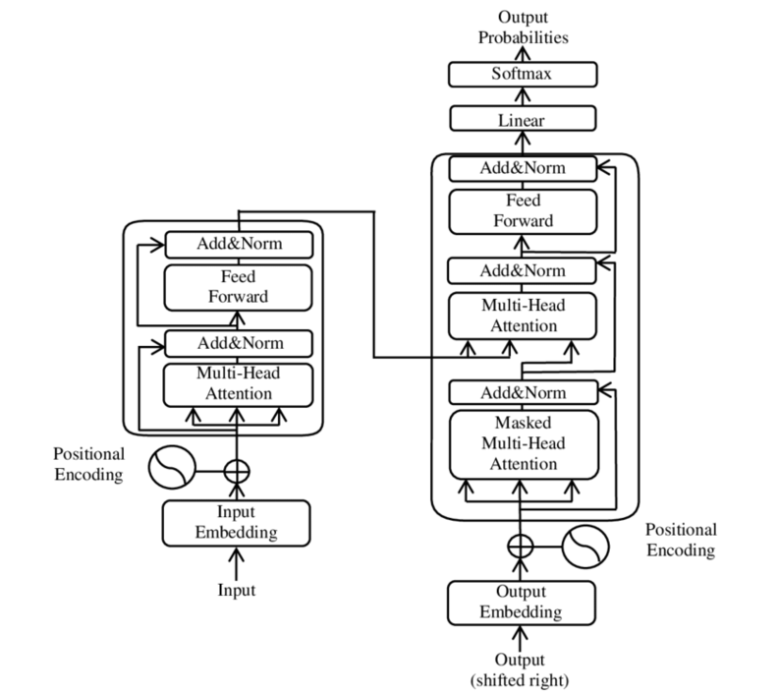

Slide 13
Figure 1-7

Slide 14
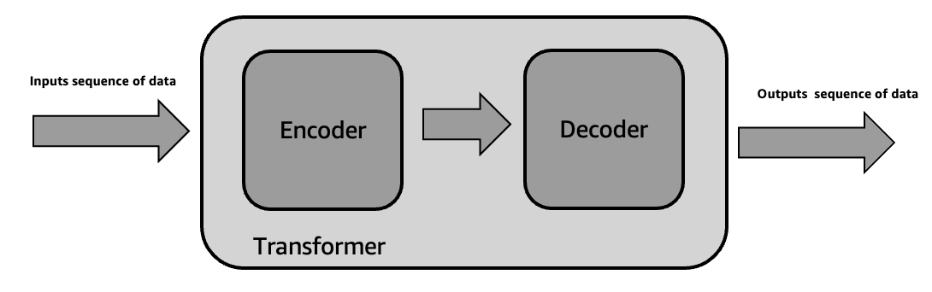
The cat chased the rat in the kitchen.
El gato persiguió a la rata en la cocina
Notes:
Figure 1.7 – Schematic diagram of Transformer Architecture

Slide 15
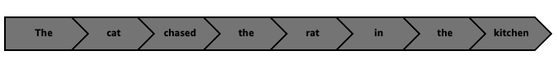
The cat chased the rat in the kitchen.
El gato persiguió a la rata en la cocina

Slide 16
Figure 1-8

Slide 17
Decoder
Encoder 1
Encoder 2
Outputs sequence of data
Inputs sequence of data
Transformer
Notes:
El gato persiguió a la rata en la cocina

Slide 18
Figure 1-9

Slide 19
Decoder
Multi head attention
Feedforward network
Multi head attention
Feedforward network
Outputs sequence of data
Inputs sequence of data
Encoder 1
Encoder 2
Encoder stack
Transformer
Notes:
El gato persiguió a la rata en la cocina

Slide 20
Figure 1-10

Slide 21
Decoder
Input Embedding
Position Encoding
Multi head attention
Feedforward network
Multi head attention
Feedforward network
Outputs sequence of data
Inputs sequence of data
Encoder 1
Encoder 2
Encoder stack
Transformer
Notes:
El gato persiguió a la rata en la cocina

Slide 22
Figure 1-11

Slide 23
Input Embedding
Position Encoding
Multi head attention
Feedforward network
Multi head attention
Feedforward network
Features
Inputs sequence of data
Encoder 1
Encoder 2
Transformer
Encoder stack
Notes:
El gato persiguió a la rata en la cocina

Slide 24
Figure 1-12

Slide 25
Residual connections
Input Embedding
Position Encoding
Multi head attention
Feedforward network
Multi head attention
Feedforward network
Features
Inputs sequence of data
Encoder 1
Encoder 2
Transformer
Encoder stack
Notes:
El gato persiguió a la rata en la cocina

Slide 26
Figure 1-13

Slide 27
Residual connections
Input Embedding
Position Encoding
Multi head attention
Feedforward network
Multi head attention
Feedforward network
Features
Inputs sequence of data
Encoder 1
Encoder 2
Encoder stack
Position Encoding
Outputs sequence of data
Input Embedding
Decoder 1
Decoder 2
Encoder stack
Transformer
Notes:
El gato persiguió a la rata en la cocina

Slide 28
Figure 1-14

Slide 29
Residual connections
Input Embedding
Position Encoding
Multi head attention
Feedforward network
Multi head attention
Feedforward network
Features
Inputs sequence of data
Encoder 1
Encoder 2
Encoder stack
Masked Multi-Head Attention
Multi head attention
Feedforward network
Masked Multi-Head Attention
Multi head attention
Feedforward network
Outputs sequence of data
Position Encoding
Input Embedding
Decoder 1
Decoder 2
Encoder stack
Transformer
Notes:
El gato persiguió a la rata en la cocina

Slide 30
Figure 1-15

Slide 31
The
food
at
the
<MASK>
was
excellent
kitchen
Masked Language Model
bi-directional context
Original Prompt “The food at the restaurant was excellent.”
Encoder
Transformer
Notes:
El gato persiguió a la rata en la cocina

Slide 32
Figure 1-16

Slide 33
The
food
at
the
??
Causal Language Model
The
food
at
the
restaurant
??
The
food
at
the
restaurant
was
??
uni-directional context
Encoder
Original Prompt: Complete the sentences “The food at the”
Transformer
Notes:
El gato persiguió a la rata en la cocina

Slide 34
Figure 1-17

Slide 35
The
food
at
the
<MASK>
<MASK>
excellent
kitchen
Span Corruption
The
food
at
the
<Sentinel Token>
excellent
kitchen
Original Prompt “The food at the restaurant was excellent.”
Encoder
Decoder
Transformer
Notes:
El gato persiguió a la rata en la cocina

Slide 36
Figure 1-18

Slide 37
Artificial Intelligence
Machine Learning
Deep Learning
Generative AI
Data Science
Enterprise Data
&
Metadata
Big Data

